Slide 1
Roster Verification 2018 Principal and District RV Coordinator Training

Slide 2
Recording

Slide 3
Protocol/Norms
All voices heard—Please use question feature & do make requests for microphone
Respect all
Be candid, constructive and non-defensive
No birdwalking
Be fully present
Be quick, but don’t hurry
Notes:
Non-defensive refers to US!

Slide 4
District Coordinators & Principals
Notes:
District coordinators were identified during the Intent to Participate status. They have the ability to see roster verification across all buildings in a district. Principals are the people who are responsible for checking school setup, monitoring teacher completion of roster verification and reviewing and approving rosters.

Slide 5
District Coordinators & Principals
Can view roster verification from a district perspective with the ability to see progress in all buildings.
Will receive three emails—one at the beginning of School Setup; another near the conclusion of teacher roster verification and a final communication three days before the close of roster verification.
Notes:
District coordinators were identified during the Intent to Participate status. They have the ability to see roster verification across all buildings in a district. Principals are the people who are responsible for checking school setup, monitoring teacher completion of roster verification and reviewing and approving rosters.

Slide 6
District Coordinators & Principals
Responsible for checking school setup, monitoring teacher completion and reviewing and approving rosters.
Receive up to eight email reminders.
Principals are the only people who have the “Linkage School Approver – Principal Only” role in roster verification.
Notes:
District coordinators were identified during the Intent to Participate status. They have the ability to see roster verification across all buildings in a district. Principals are the people who are responsible for checking school setup, monitoring teacher completion of roster verification and reviewing and approving rosters.

Slide 7
Agenda
Introductions & Welcome
Roster Verification Overview/Rationale
ESC Roster Verification “Nuances”
2018 Guidelines and FAQs
Training Resources
Support Resources
BFK Link® CE for Principals/Supervisors
BFK Link® CE for Teachers
Questions? | Last Pass

Slide 8
Introductions & Welcome
Scott Walthour & Mary Adams
Contact us by submitting help desk tickets at https://www.ohio-k12.help/rosterv/
or calling
Call 844-K12-Ohio = 844-512-6446

Slide 9
Poll #1
Poll #1
Notes:
Question is in GoToWebinar—How familiar are you with RV?

Slide 10
What is Roster Verification?
Roster Verification is the process that facilitates validation of which teacher teaches what subject to which students in support of value-added student growth measures.
Roster verification directly involves educators in the process that assigns instructional responsibility for the students they teach.
Below please see the final participation numbers from RV 2017.
Providers | LEAs | Schools | Educators | Rosters | Students
BFK | 86 | 370 | 7,228 | 37,277 | 200,768
MCOECN | 995 | 2,786 | 42,132 | 214,500 | 1,276,870
Total | 1,081 | 3,156 | 49,360 | 251,777 | 1,477,638

Slide 11
Transparency
Notes:
Roster Verification is about transparency—Giving teachers access to a tool that allows them the to ensure the accuracy of the rosters that are included in their value-added calculations.

Slide 12
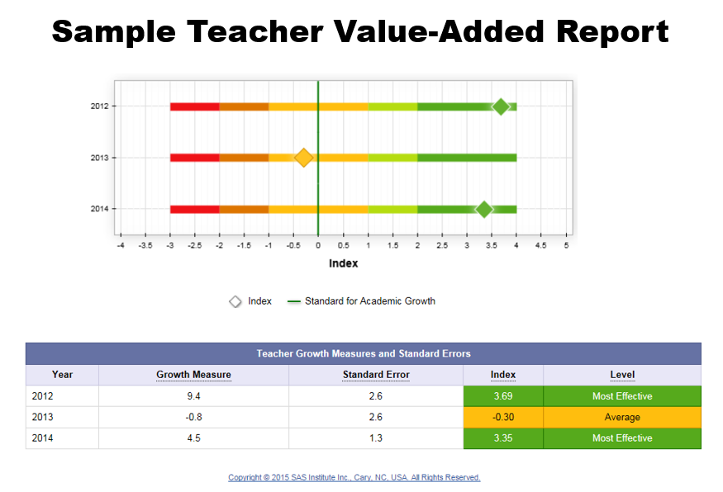
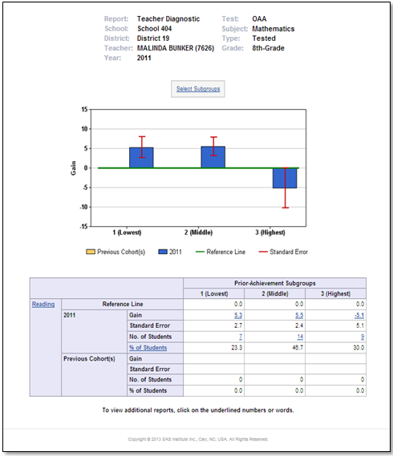
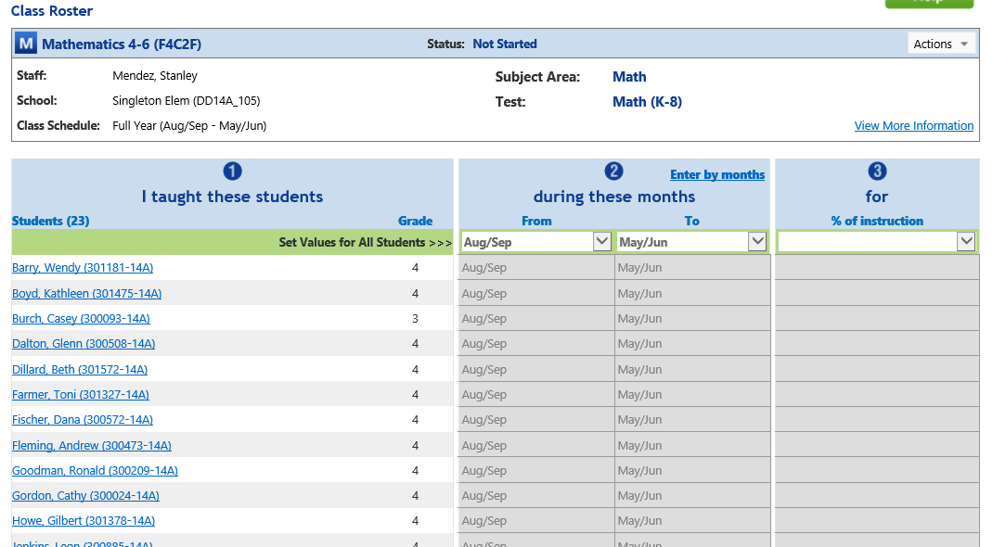
Roster Verification Building Trust
Trust
Notes:
This slide shows the relationship between RV input and Value-Added output—Analysis and Diagnostic Reports.

Slide 13
Educators verify the following four pieces of information
The grades/classes/subjects they taught;
The students who received instruction from them; REMINDER: WE ARE NOT REPLACING STUDENT NAMES IN BFK•LINK ® CE WITH NAMES FROM THE IBM SSID SYSTEM!
The months during which students received instruction from them; and
The percentage of instructional responsibility they had for each student during the months selected (verifying a percentage of sole or shared instructional responsibility).
Notes:
Four pieces of information being verified…

Slide 14
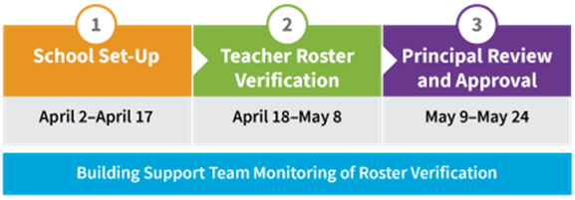
Timeline for Roster Verification
January & February, 2018 – Intent & authorization completed by Superintendent
March 1 through March 23, 2018 – data loading processes completed
Prior to April 2 – confirmation of access for district principals
Notes:
This is the timeline for Roster Verification 2018

Slide 15
Scope
Statewide: all licensed/certified teachers planning and/or providing instruction for students in:
Grades 4, 5, 6, 7 and 8 Math and English Language Arts;
Grades 5 and 8 Science.
HIGH SCHOOL
Algebra I for high school credit;
American Government for high school credit;
American History for high school credit;
Biology for high school credit;
English I & II for high school credit;
Geometry for high school credit; and
Integrated Math I & II for high school credit.
Notes:
The only course that has been removed is 6th grade Social Studies.

Slide 16
Purposes | Scores | Formulas | Tests | Roster Data | Participants
EVAAS Informing OTES Instructional Practice | Teacher-level Value-Added Scores | SAS Processes & Formulas | Student Test Scores | SIS RosterV Data EMIS Verified by Teachers ------------------------------- EMIS Unverified by Teachers | REQUIRED Teachers in traditional public school districts, including JVSs, CTCs and ESCs are required to have value-added in select grades and subjects. OPTIONAL: Community school teachers are not required to have teacher-level value-added scores.
District & Building Report Cards + OPES | Building & District Value-Added Scores | SAS Processes & Formulas | Student Test Scores | EMIS | All Districts and Buildings: traditional public schools, including JVSs, CTCs, & ESCs as well as community schools.
Teacher-Level Value-Added
Teachers (some, not all)
District & Building Value-Added
All Districts & Buildings
Notes:
-developed to demystify differences between Teacher Leve & district Level

Slide 17
Purposes | Scores | Formulas | Tests | Roster Data | Participants
EVAAS Informing OTES Instructional Practice |  |  |  |  | REQUIRED Teachers in traditional public school districts, including JVSs, CTCs and ESCs are required to have value-added in select grades and subjects. OPTIONAL: Community school teachers are not required to have teacher-level value-added scores.
District & Building Report Cards + OPES School Improvement |  |  |  |  | All Districts and Buildings: traditional public schools, including JVSs, CTCs, & ESCs as well as community schools.
Teachers (some, not all)
←Teacher Value-Added Process→
All Districts & Buildings
←District/Bldg Value-Added Process→
Notes:
Teacher VA--Data goes to EVAAS and on the evaluation side it goes to OTES
Some teachers, not all
Who doesn’t need to have VA—Community Schools do not have to participate in Roster Verification and do not have to have Teacher Level scores.
Substitutes—correct but not looking for this answer
ENCORE-- “
Teachers who don’t teach a subject related to VA “
On district side it goes for Report cards and OPES information

Slide 18
Purposes | Scores | Formulas | Tests | Roster Data | Participants
EVAAS Informing OTES Instructional Practice | Teacher-level Value-Added Scores |  |  |  | REQUIRED Teachers in traditional public school districts, including JVSs, CTCs and ESCs are required to have value-added in select grades and subjects. OPTIONAL: Community school teachers are not required to have teacher-level value-added scores.
District & Building Report Cards + OPES School Improvement | Building & District Value-Added Scores |  |  |  | All Districts and Buildings: traditional public schools, including JVSs, CTCs, & ESCs as well as community schools.
Teachers (some, not all)
All Districts & Buildings
Notes:
Both the Teacher & Building calculations come from a company named SAS.

Slide 19
Purposes | Scores | Formulas | Tests | Roster Data | Participants
EVAAS Informing OTES Instructional Practice | Teacher-level Value-Added Scores | SAS Processes & Formulas |  |  | REQUIRED Teachers in traditional public school districts, including JVSs, CTCs and ESCs are required to have value-added in select grades and subjects. OPTIONAL: Community school teachers are not required to have teacher-level value-added scores.
District & Building Report Cards + OPES School Improvement | Building & District Value-Added Scores | SAS Processes & Formulas |  |  | All Districts and Buildings: traditional public schools, including JVSs, CTCs, & ESCs as well as community schools.
Teachers (some, not all)
All Districts & Buildings
Notes:
SAS—a company out of North Carolina uses similar, but not the same calculations ,to get the building and teacher scores

Slide 20
Purposes | Scores | Formulas | Tests | Roster Data | Participants
EVAAS Informing OTES Instructional Practice | Teacher-level Value-Added Scores | SAS Processes & Formulas | Student Test Scores |  | REQUIRED Teachers in traditional public school districts, including JVSs, CTCs and ESCs are required to have value-added in select grades and subjects. OPTIONAL: Community school teachers are not required to have teacher-level value-added scores.
District & Building Report Cards + OPES School Improvement | Building & District Value-Added Scores | SAS Processes & Formulas | Student Test Scores |  | All Districts and Buildings: traditional public schools, including JVSs, CTCs, & ESCs as well as community schools.
Teachers (some, not all)
All Districts & Buildings
Notes:
The Tests are the same tests used for both Teacher & Building scores they are the student test scores.

Slide 21
Purposes | Scores | Formulas | Tests | Roster Data | Participants
EVAAS Informing OTES Instructional Practice | Teacher-level Value-Added Scores | SAS Processes & Formulas | Student Test Scores | SIS RosterV Data EMIS Verified by Teachers ------------------------------- EMIS Unverified by Teachers | REQUIRED Teachers in traditional public school districts, including JVSs, CTCs and ESCs are required to have value-added in select grades and subjects. OPTIONAL: Community school teachers are not required to have teacher-level value-added scores.
District & Building Report Cards + OPES School Improvement | Building & District Value-Added Scores | SAS Processes & Formulas | Student Test Scores | EMIS | All Districts and Buildings: traditional public schools, including JVSs, CTCs, & ESCs as well as community schools.
RV Intent=Yes V-A Required or Community School opt-in
Teachers (some, not all)
Only used for required districts that decline Intent
All Districts & Buildings
Notes:
If a Superintendent’s intent is yes; they have a choice of using either SIS data or EMIS data to inform Roster Verification
If you are in a district and are required to participate, If a Superintendent says No, then EMIS data that is unverified by teachers will be used to calculate Value Added for the teachers.
District & Building calculations use EMIS data calculated with the Student Test Scores.

Slide 22
Purposes | Scores | Formulas | Tests | Roster Data | Participants
EVAAS Informing OTES Instructional Practice | Teacher-level Value-Added Scores | SAS Processes & Formulas | Student Test Scores | SIS RosterV Data EMIS Verified by Teachers ------------------------------- EMIS Unverified by Teachers | REQUIRED Teachers in traditional public school districts, including JVSs, CTCs and ESCs are required to have value-added in select grades and subjects. OPTIONAL: Community school teachers are not required to have teacher-level value-added scores.
District & Building Report Cards + OPES School Improvement | Building & District Value-Added Scores | SAS Processes & Formulas | Student Test Scores | EMIS | All Districts and Buildings: traditional public schools, including JVSs, CTCs & ESCs as well as community schools.
Notes:
Required
Optional—as far as Teacher Value Added
Building & District always use EMIS & Student Test Scores

Slide 23
Agenda
Introductions & Welcome
Roster Verification Overview/Rationale
ESC Roster Verification “Nuances”
2018 Guidelines and FAQs
Training Resources
Support Resources
BFK Link® CE for Principals/Supervisors
BFK Link® CE for Teachers
Questions? | Last Pass
Notes:
We’ll now dive into specific nuances related to the participation of ESCs.

Slide 24
ESC Nuances
All Educational Service Centers (ESCs) receive roster verification services from the Management Council of the Ohio Education Computer Network (MCOECN). Participating ESCs will be loaded into the application as their own district. They must also designate an individual to perform the administrative functions associated with roster verification (previously requested).
Notes:
ESCs all served by the Management Council.
Must have someone serving in the “Principal – School Approver” role.

Slide 25
Educational Service Center Rosters
District B
ESC
Supv
District A
District C
Notes:
Designated educational service center supervisors or directors will perform roster verification administrative functions – school setup, the monitoring of teacher roster verification and the review and approval process – for all educational service center rosters composed of students from multiple districts. In cases where an educational service center roster is composed of students exclusively from one district, the building principal will perform these roster verification administrative functions. Educational service center rosters should be reviewed carefully. If rosters are inadvertently deleted or not loaded, educational service center supervisors or teachers may need to enter the data directly into BFK•Link®.

Slide 26
Educational Service Center Rosters
District B
Principal
District A
District C
Notes:
Designated educational service center supervisors or directors will perform roster verification administrative functions – school setup, the monitoring of teacher roster verification and the review and approval process – for all educational service center rosters composed of students from multiple districts. In cases where an educational service center roster is composed of students exclusively from one district, the building principal will perform these roster verification administrative functions. Educational service center rosters should be reviewed carefully. If rosters are inadvertently deleted or not loaded, educational service center supervisors or teachers may need to enter the data directly into BFK•Link®.

Slide 27
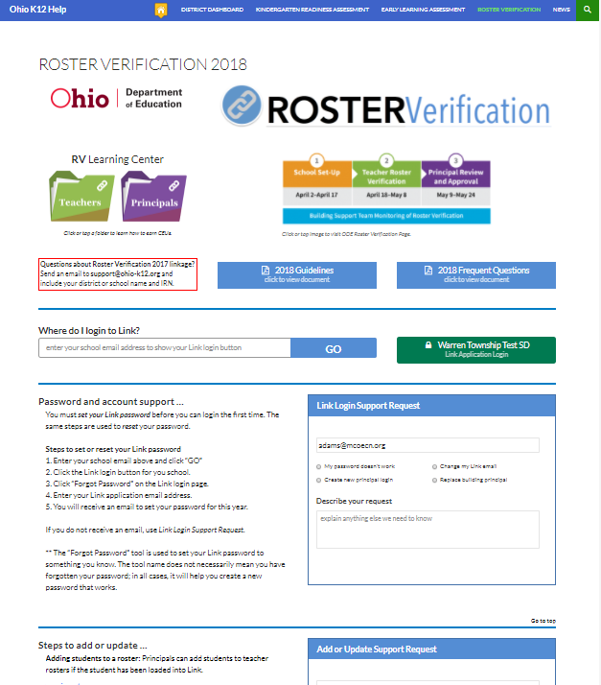
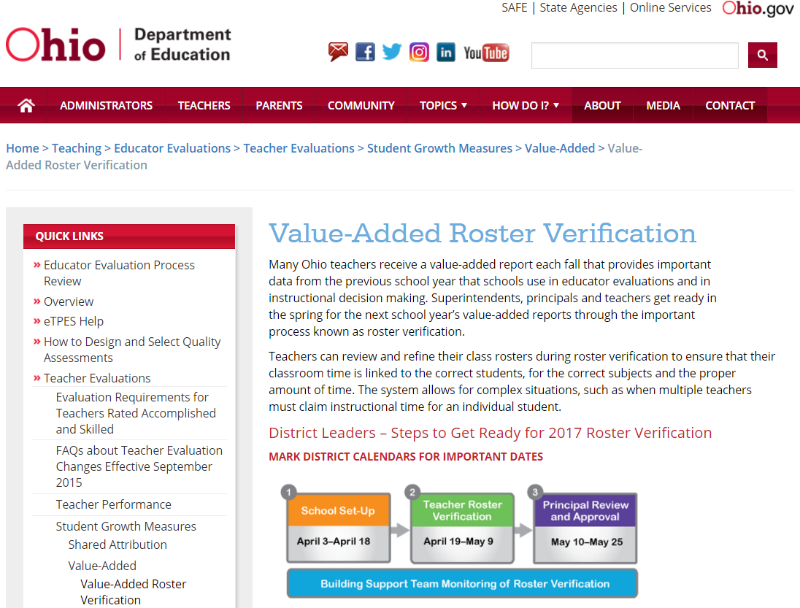
Roster Verification Websites
ODE—Type “roster verification” in search bar to find this page
https://www.ohio-k12.help/rosterv/
Notes:
The webpage on the left is ODE’s Roster Verification page; the webpage on the right is the Management Council’s roster verification support page.

Slide 28
https://www.ohio-k12.help/rosterv/
Timeline
Guidelines
Frequently Asked Questions
Login with email address
Step-through support
Notes:
Timelines and general information can be found on the first tab of the Management Council’s webpage supporting roster verification.

Slide 29
Agenda
Introductions & Welcome
Roster Verification Overview/Rationale
ESC Roster Verification “Nuances”
2018 Guidelines and FAQs
Training Resources
Support Resources
BFK Link® CE for Principals/Supervisors
BFK Link® CE for Teachers
Questions? | Last Pass
Notes:
2018 Roster Verification Guidelines and FAQs

Slide 30
https://www.ohio-k12.help/rosterv/
Guideline & FAQs
Notes:
Show location of Guidelines and FAQs on the Management Council’s webpage for RV support.

Slide 31
Key Guidelines and FAQs
Notes:
Quiz questions: (Polls #2, 3 & 4)
Should teachers or principals remove students from their rosters because of attendance?
Long-term substitutes participate in roster verification;
Which of the following is always true?

Slide 32
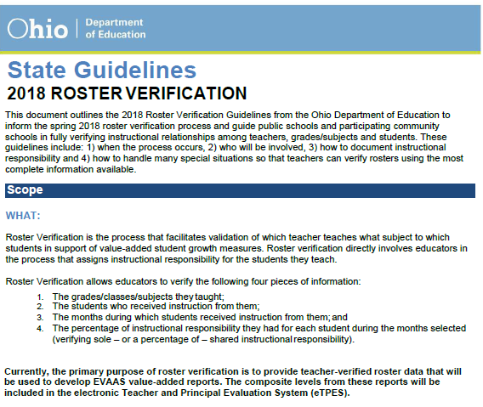
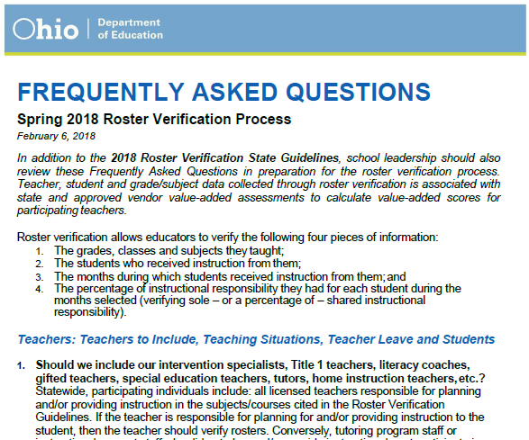
Guidelines and FAQs
Highlights only
Notes:
Please be sure to read through the RV 2018 Guidelines. Make sure everyone knows the tests students take this spring will be used to calculate teacher-level value-added scores.

Slide 33
Agenda
Introductions & Welcome
Roster Verification Overview/Rationale
ESC Roster Verification “Nuances”
2018 Guidelines and FAQs
Training Resources
Support Resources
BFK Link® CE for Principals/Supervisors
BFK Link® CE for Teachers
Questions? | Last Pass
Notes:
Training Resources

Slide 34
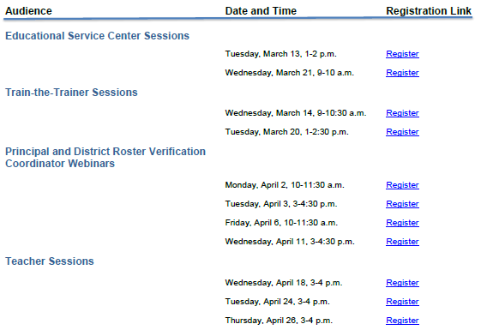
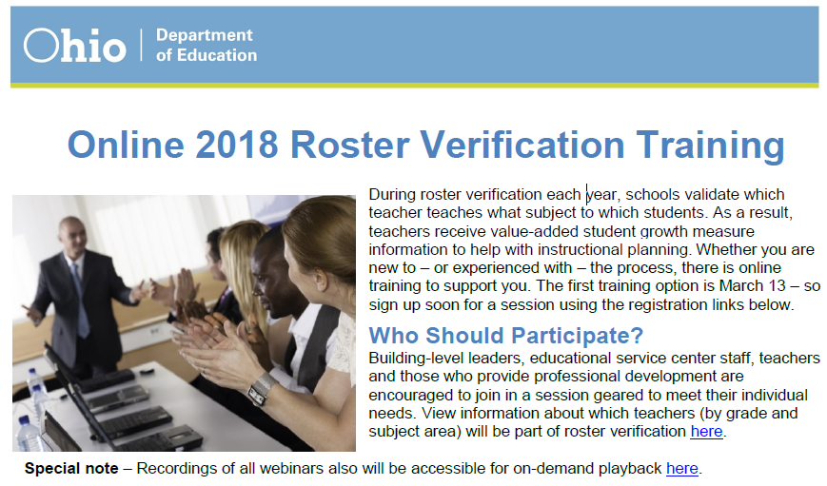
District Training Opportunities
Notes:
Found on the main website

Slide 35
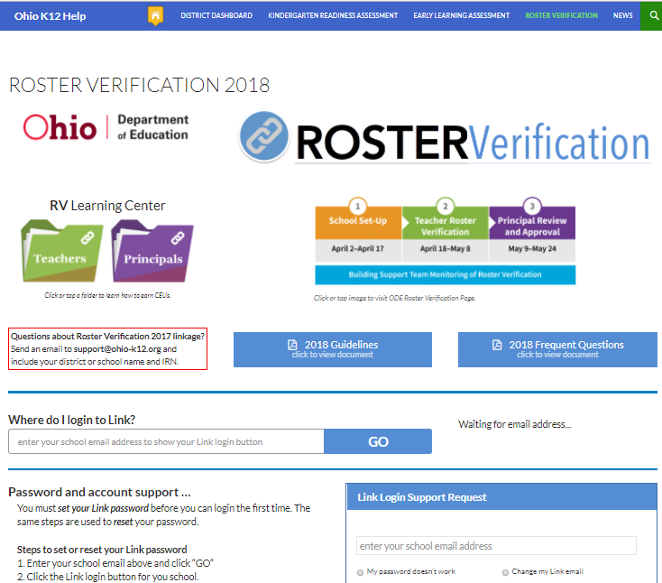
Principal & Teacher Learning Modules
Anytime/Anywhere there’s an Internet connection educators can access two learning modules, one for principals, the other for teachers. Both learning modules conclude with a quiz. Those getting 80% or higher may receive CEU credit.
Notes:
The #1 resource for principal and teachers are interactive learning modules. Both modules—one for principals, the other for teachers—conclude with a quiz that if passed, presents a CEU certificate.

Slide 36
Agenda
Introductions & Welcome
Roster Verification Overview/Rationale
ESC Roster Verification “Nuances”
2018 Guidelines and FAQs
Training Resources
Support Resources
BFK Link® CE for Principals/Supervisors
BFK Link® CE for Teachers
Questions? | Last Pass
Notes:
Support Resources

Slide 37
Accessing Support
Preference is for users to submit help desk tickets, however…
Phone support is also available at 844-K12-Ohio 844-512-6446
Here you will find step-through help as well as the support ticket if needed.
Notes:
Support for roster verification can be found on the RV Provider/Contact Support tab on the Management Council’s webpage for roster verification. Support is available via a web form and phone.

Slide 38
Agenda
Introductions & Welcome
Roster Verification Overview/Rationale
ESC Roster Verification “Nuances”
2018 Guidelines and FAQs
Training Resources
Support Resources
BFK•Link®CE for Principals (or ESC Supervisors)
BFK•Link®CE CE for Teachers
Questions? | Last Pass
Notes:
BFK•Link®CE for Principals (or ESC Supervisors)

Slide 39
BFK•Link®CE –Login
This link will be available on April 2, 2018
1. Type in your district provided email address.
2. Click on “GO”—Your school will be displayed on the right.
3. Click on the button with the appropriate school you need to access.

Slide 40
BFK•Link® CE
BFK•Link® CE is the online application principals and teachers use for roster verification. Their username is their school email address. Everyone must use the “Forgot Password” link to establish their password the first time they log in.
Notes:
Please explain that district roster verification administrators, principals and teachers will receive email messages with the URL for logging into BFK•Link® CE. These are timed based on the three phases of roster verification. Login access will not begin until April 2nd. Please note that everyone must use the “Forgot Password” link to establish their password the first time they log in.

Slide 41
Password Reset—as a rule; ask the user to go to BFK•Link® CE to reset their own password
NOTE: All users need to click on “Forgot Password” the first time they login to BFK Link CE.
User enters their email address and the password is reset for them.
Notes:
--but if the user is having trouble and really can’t reset the password then either the ITC or user can enter a ticket on the website and the help-desk will update/create.

Slide 42
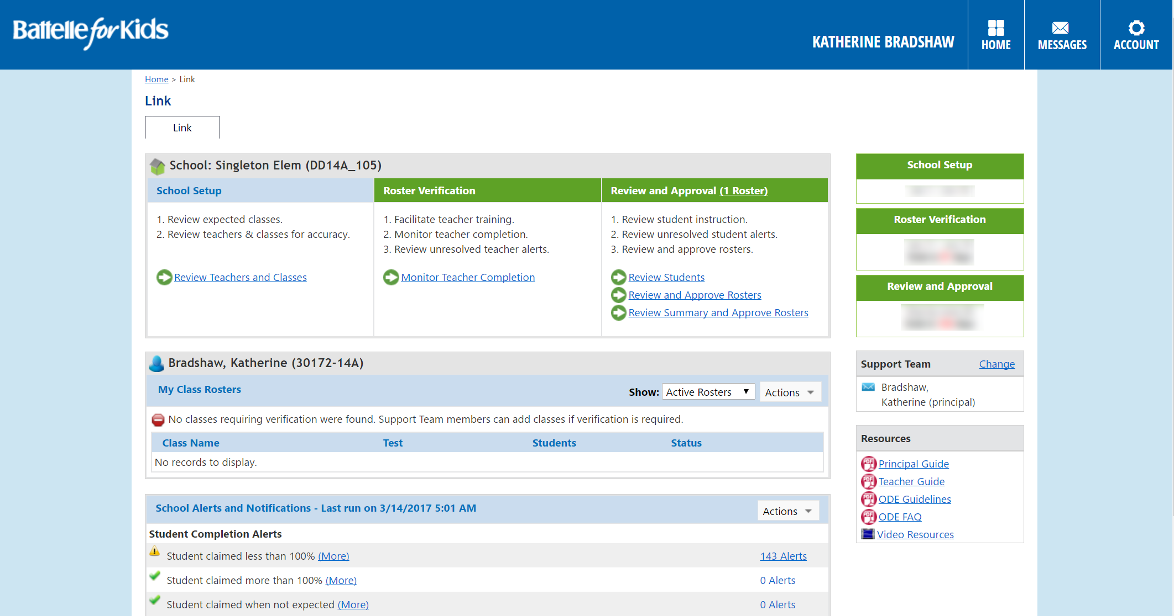
Building Support Team & Resources
Before starting the Roster Verification Process, districts are encouraged to identify Building Support Team members. Suggestions for support team members include:
Curriculum coordinator
Experienced teachers
Assistant principal
Guidance counselor
Please note resources available within BFK•Link®CE

Slide 43
Poll #7
Poll #7
Notes:
Poll #7--What's the easiest way principals can tell whether all rosters have been submitted by teachers?

Slide 44
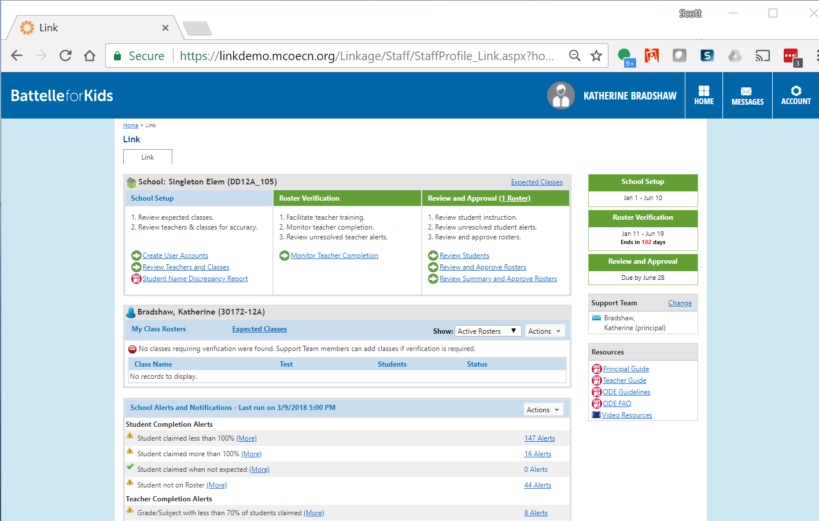
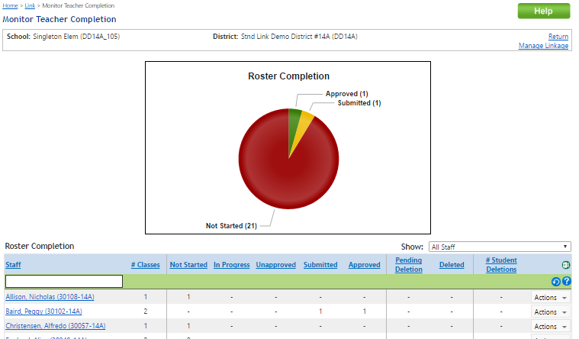
New Functionality
This is a principal’s dashboard, showing all three phases
Check to make sure all teachers and classes are present.
April 2 - 17
April 19 – May 9
May 9 – May 24
Principals may…
Add or remove teachers
Add or remove classes
Transfer classes to other teachers
Setup team teaching
Create building support team
Principals monitor teacher completion of roster verification
Monitor and correct alerts
Approve rosters
Contact state support to add students not loaded from district data
USE DASHBOARD FUNCTION.
Principal’s best friend!
Notes:
This is the principal’s dashboard showing all three phases of roster verification.
In Phase One—School Setup (April 2 –April 17)--make sure all teachers and their courses are present in the application.
In Phase Two--Teacher Roster Verification (April 18-May 8)--monitor completion of roster verification by their teachers.
In Phase Three—Principal Review and Approval (May 9-May24)--go through teacher submissions, making corrections and insuring all rosters that should be submitted are in an approved state.
Please note that only rosters that are in a submitted or approved state will be used in value-added calculations.

Slide 45
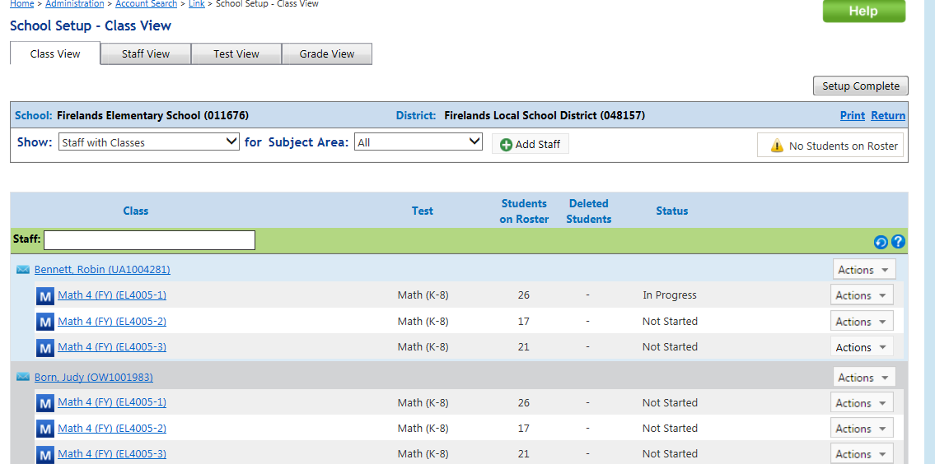
Principal’s view for School Setup
Notes:
Each tab at the top can be an option for the Principal to view the building information:
Show staff view
Show test view
Show grade level view

Slide 46
Principal’s View for School Setup— email accounts
Staff email icon
NOTE: if a staff member has an email address on file, it will be indicated with this icon. If there is no icon, then there will be an alert generated for the staff members with rosters.
Please Note: All staff must have a valid email address to log in and receive communications.
Notes:
Each teacher and employee must have an email account in the system
If a teacher/employee does have an email address, NOTE the email icon next to the staff name
New this year is an alert for “teachers with rosters and missing email accounts”
Principals can click on this alert and type in the email address
Once there is an email address the only way to edit it is to have the support desk fix it.

Slide 47
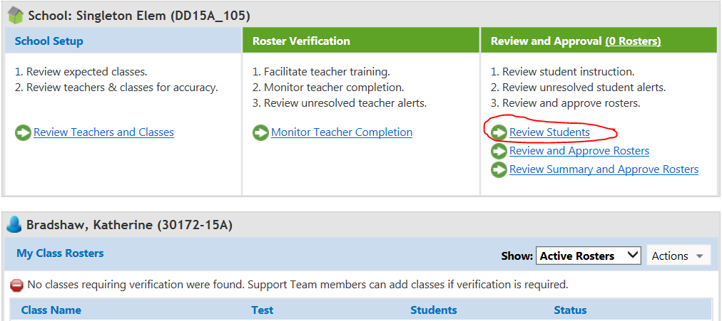
Adding Staff & Students to Buildings
Most frequently requested item will be to add staff & students to a building. Principals can add to their own buildings if the information is loaded anywhere in the district.
Notes:
If the Staff or student isn’t in the district data they will need to enter a ticket on the website and the help desk will add the student to the district.

Slide 48
Adding Staff & Students to Buildings
In the actions box; the Principal can add any student or staff member from the district to their school building.

Slide 49
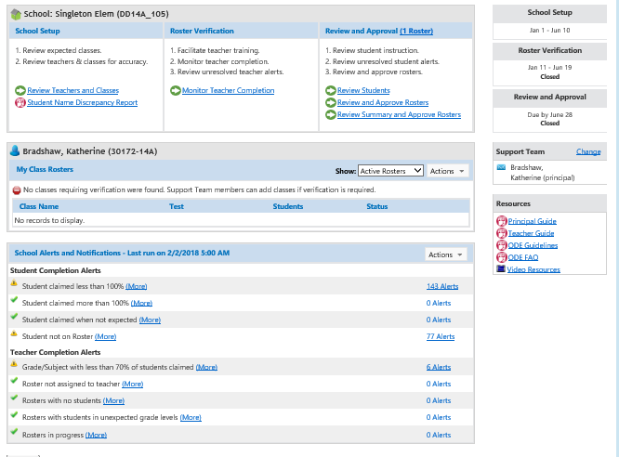
Alerts – Refresh and Review
Actions – Refresh
Note Student and Teacher Alert types
Select the number of Alerts
View alerts for each student
Correct or Acknowledge alerts
4/2/18-4/17/18
4/18/18-5/8/18
5/9/18-5/24/18
Click on the blue total number of alerts link.

Slide 50
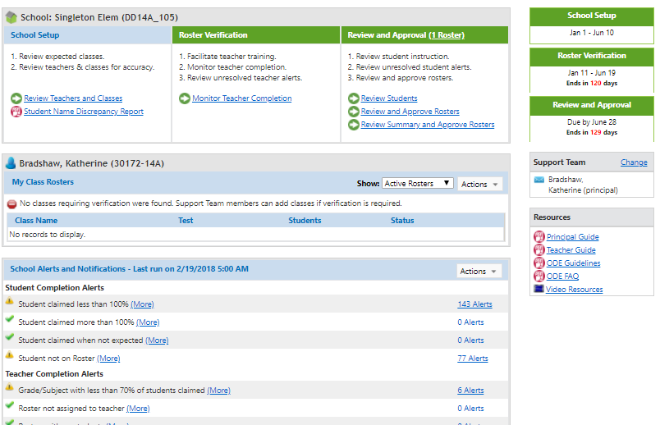
Student Name Discrepancies Report
Principals will be able to run this report which will show student name discrepancies between the SIS system and the IBM-State Student ID (SSID) system. The SIS Link loader will load names as they appear in the SIS into BFK•Link® CE
so teachers will see the names they are used to seeing. However, the student names shown in EVAAS and eTPES will be from the IBM SSID system.
Student Name Discrepancies Report

Slide 51
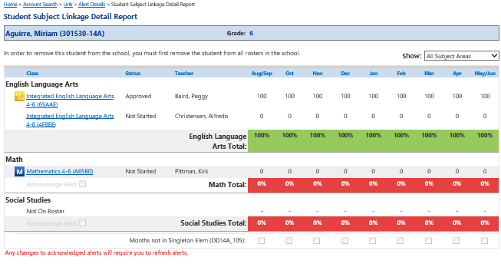
Student Alert Details
Acknowledge
Alert
Notes:
This screen displays the details related to the alert for Miriam. If we know the reason for the alert we can acknowledge the alert or click on the class and address the alert.

Slide 52
Teacher Completion Alerts
Roster not assigned to teacher
Looks for rosters not associated with a teacher because the teacher record was incomplete
Need to update the teacher record
Access the roster and then transfer it to the correct teacher
Rosters with no students
Should clear if teacher adds students to a class that was created by the administrator
Notes:
If the alert is for a roster not assigned to a teacher, this alert looks for rosters not associated with a teacher because the teacher record was incomplete. The teacher record will need to be updated. Access the record and transfer it to the correct teacher

Slide 53
Warning not on the Alerts Table
Notes:
When looking at the rosters pending delete approval, you will be able to view them under View Changes
The rosters will appear (all rosters which have been modified or submitted for the teacher). The roster will show a status of Pending Delete Approval. At this point the Principal/ ESC designee/ or whoever has the principal role in RV can restore the roster, which will bring back the students; or they may approve the deletion of the roster by the teacher.

Slide 54
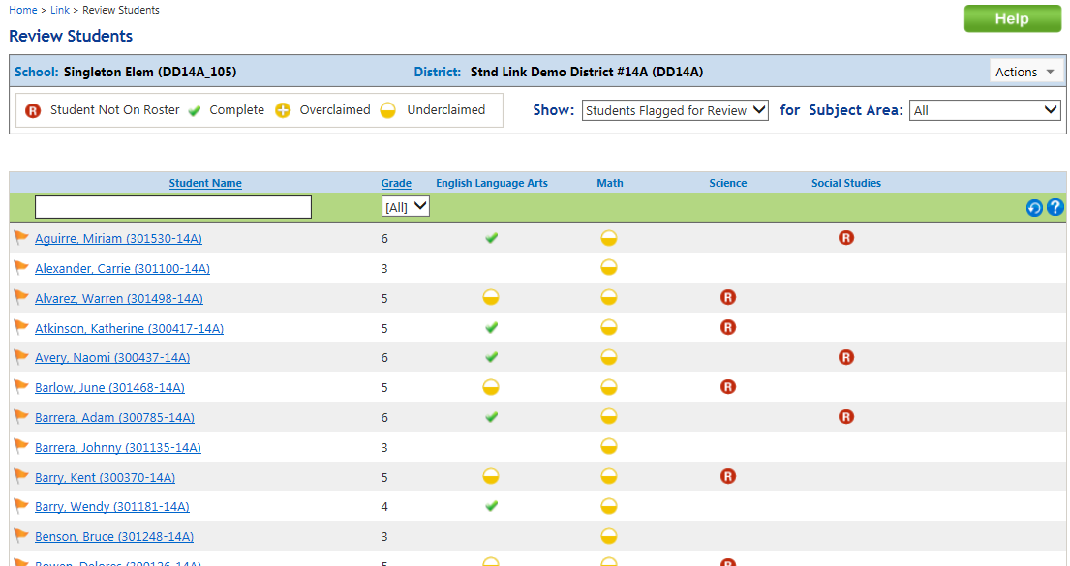
New Functionality
The Review & Approval Phase May 9 – 24
New Functionality Reminder: Principals can add students to their school buildings if the student’s information has been loaded anywhere in the district.
Review students who are flagged with an alert.

Slide 55
New Functionality
The Review & Approval Phase May 9 – 24
Principal Process (approval)
Approval of rosters
See listing of staff members who have submitted rosters for approval
Click on number of classes to view changes made to individual classes

Slide 56
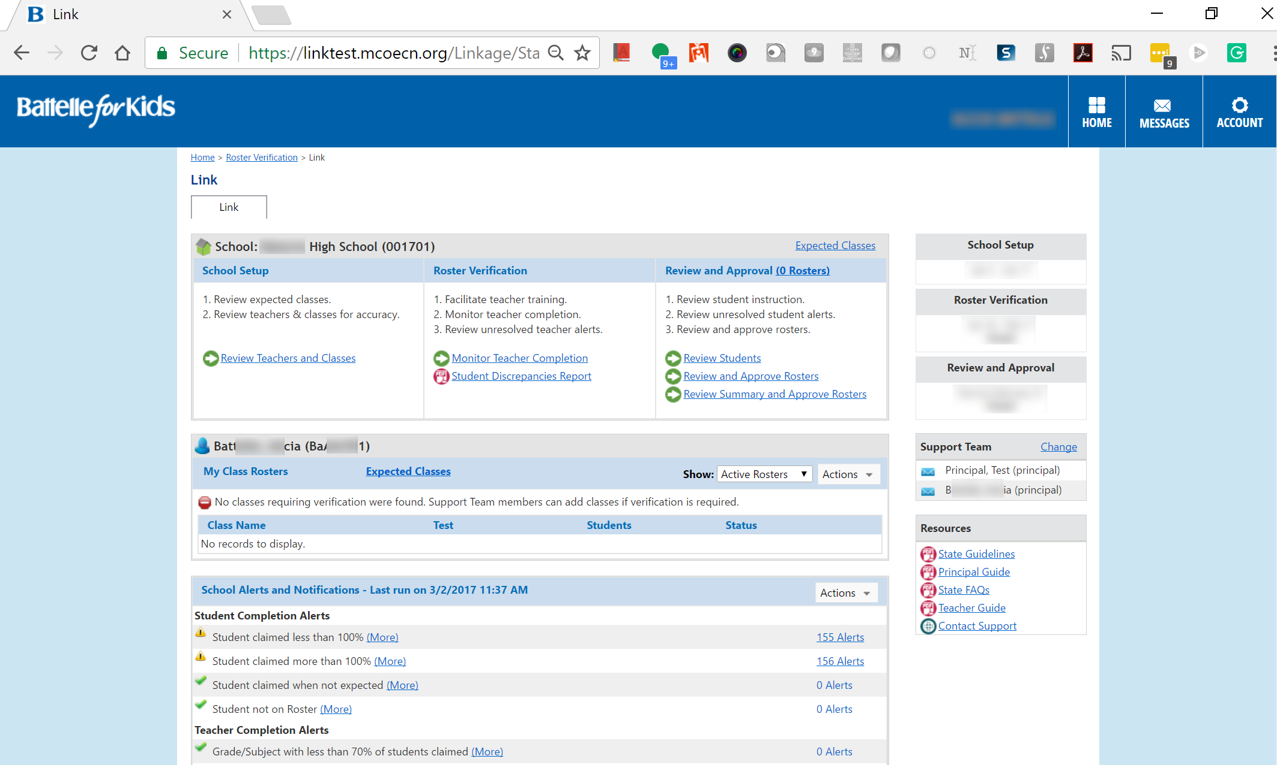
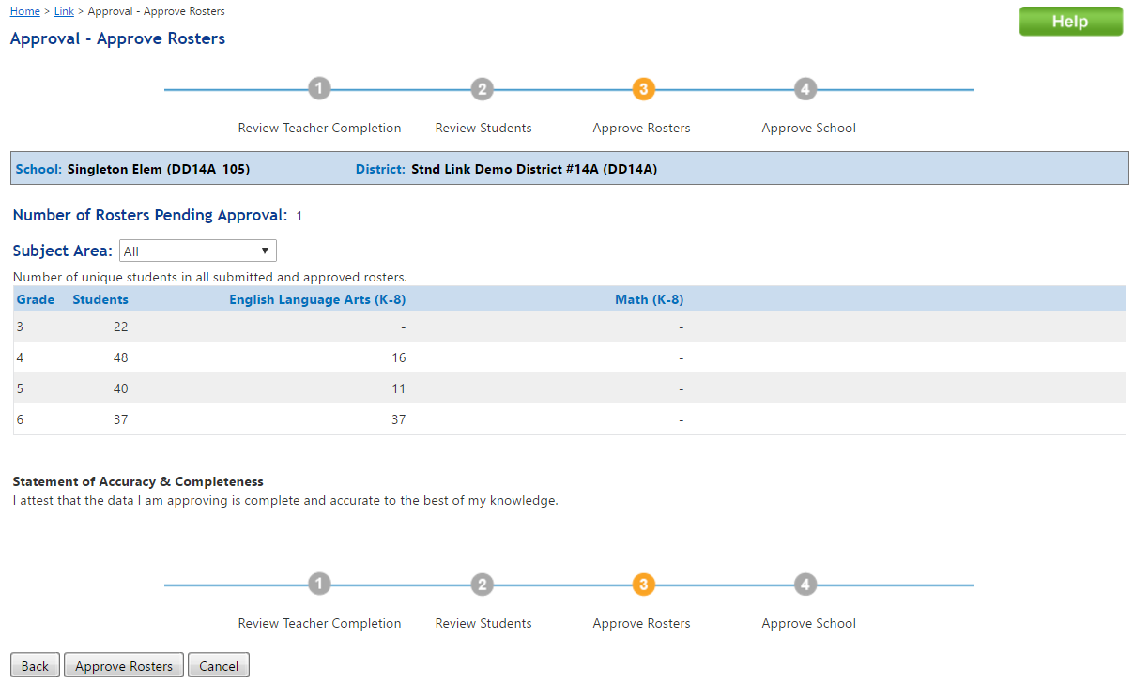
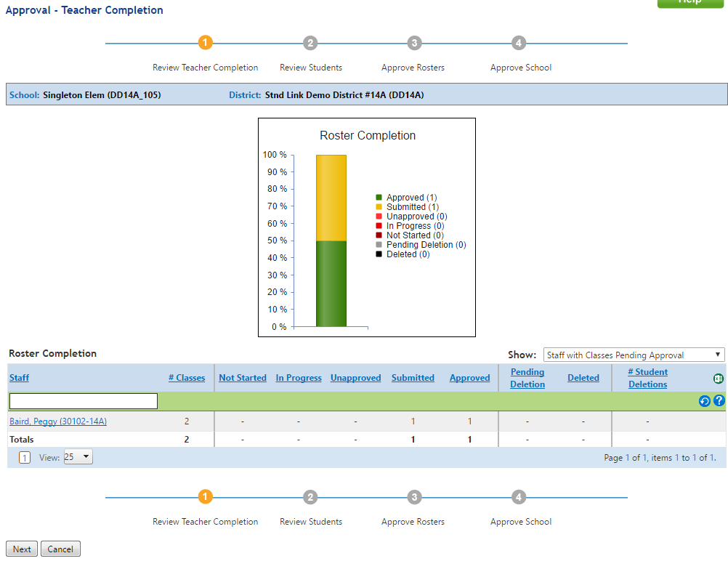
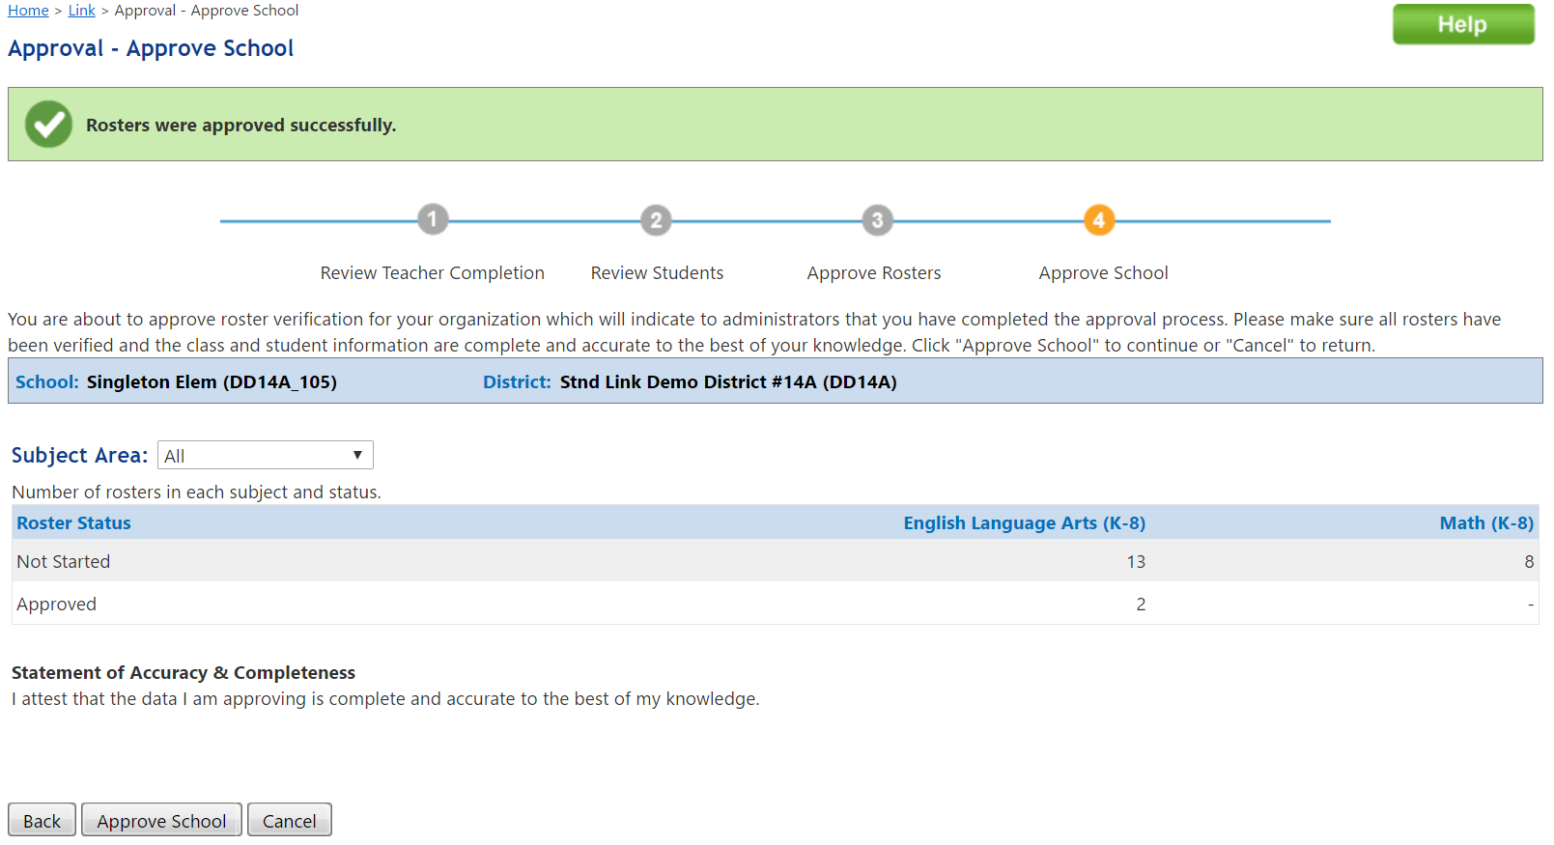
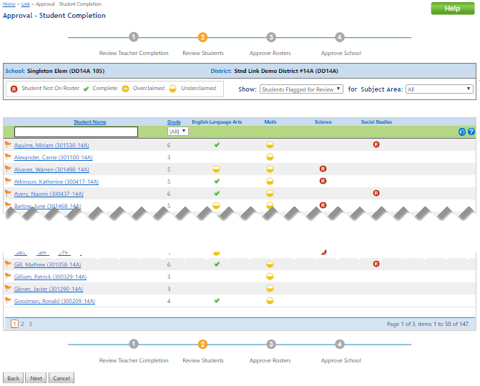
New Functionality
The Review & Approval Phase May 9 – 24
The Approve School Button does NOT affect rosters in a Not Started, In Progress or Unapproved Status! Those rosters will NOT be used in value-added calculations
Four step process
Review Teacher Completion
Review Students
Approve Rosters
Approve School
Notes:
When a principal runs the 4 step process; the “Approve School” button means that they are DONE with roster verification process and they will no longer receive notices to complete their building approval.

Slide 57
Agenda
Introductions & Welcome
Roster Verification Overview/Rationale
ESC Roster Verification “Nuances”
2018 Guidelines and FAQs
Training Resources
Support Resources
BFK•Link®CE for Principals (or ESC Supervisors)
BFK•Link®CE for Teachers
Questions? | Last Pass
Notes:
BFK•Link®CE for Teachers

Slide 58
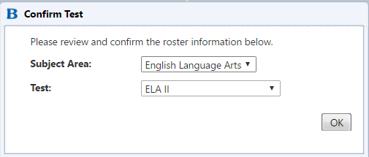
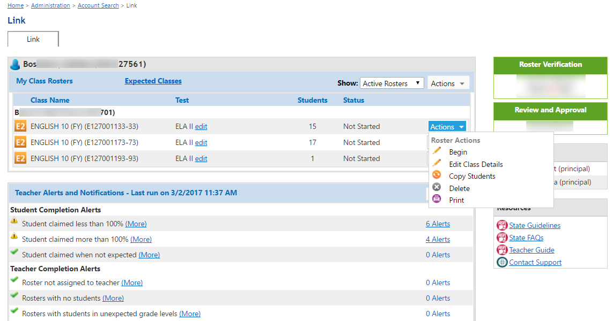
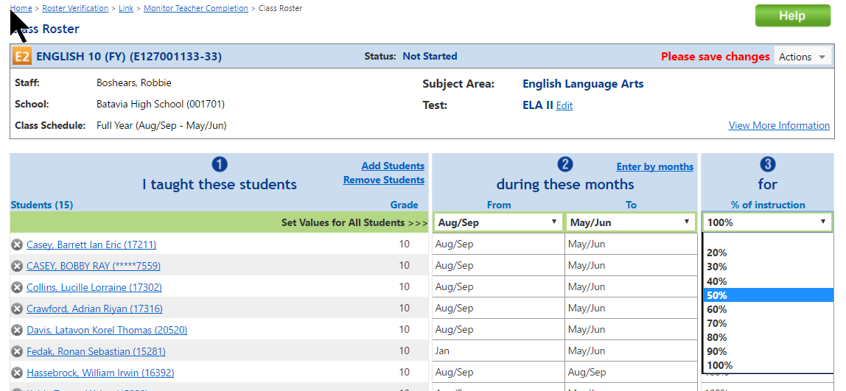
Teacher’s View for Roster Verification
#2 Confirm state test on first entry
#1 Teacher Dashboard
#3 Add/Delete Students; Enter by months; and Instructional Responsibility %
Notes:
These are screens that show how teachers interact with BFK•Link® CE. Please note that the first time teachers enter a roster they will be asked to confirm the state test being taken by students on that roster.
Teachers can update the courses they teach.
Teachers can update the students within each roster.
Teachers can update the % of time they instructed the student.
Teachers can update the months they instructed each student.
Teachers can add students from within the building—Principal will need to add them to the school.

Slide 59
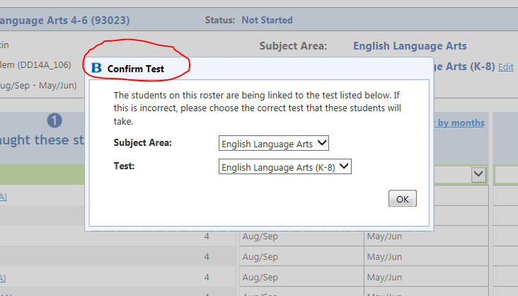
Confirm test
Notes:
Teachers can fix/change the test or subject area if it is incorrect.

Slide 60
Poll #8
Poll #8
Notes:
Poll #8--What facility in BFK Link should teachers use to roster students that leave, comeback, leave and come back again?

Slide 61
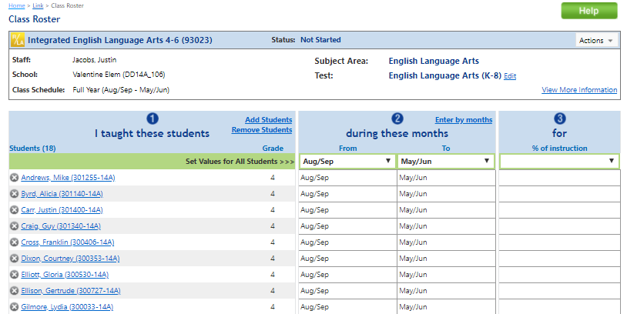
Teacher Class Roster
Notes:
--show how they can enter by month individually
--enter a default for % of instruction

Slide 62
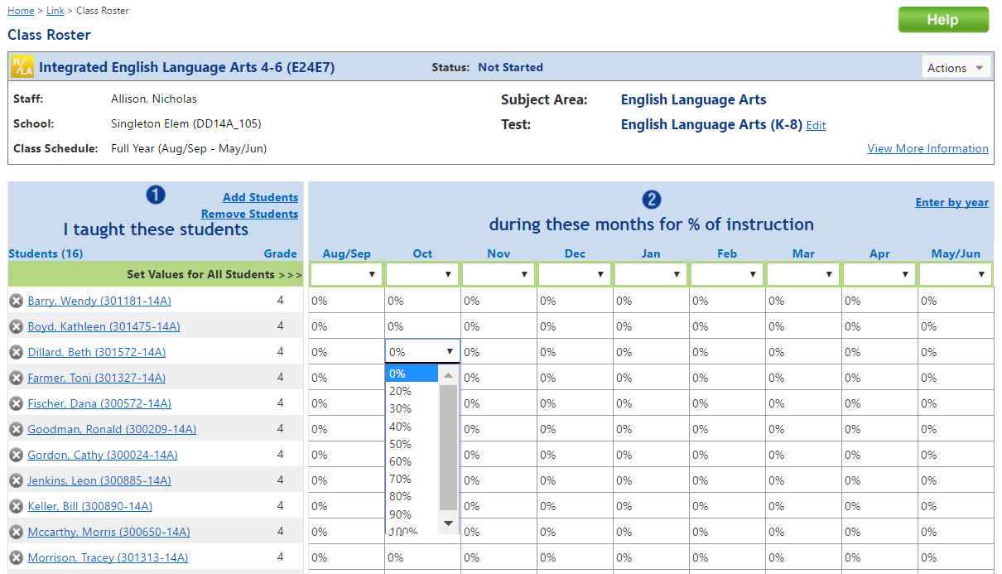
Teacher’s View for Roster Verification
Enter by months…
Notes:
How teachers enter by months—used when students are in and out multiple times.

Slide 63
Questions? Last Pass
Submit help desk tickets at https://www.ohio-k12.help/rosterv/
or call
Call 844-K12-Ohio = 844-512-6446

Slide 64
THANK YOU

